Slide 1
Decision Trees II

Slide 2
Decision Tree Example
Outlook | Temperature | Humidity | Windy | Play?
sunny | hot | high | false | No
sunny | hot | high | true | No
overcast | hot | high | false | Yes
rain | mild | high | false | Yes
rain | cool | normal | false | Yes
rain | cool | normal | true | No
overcast | cool | normal | true | Yes
sunny | mild | high | false | No
sunny | cool | normal | false | Yes
rain | mild | normal | false | Yes
sunny | mild | normal | true | Yes
overcast | mild | high | true | Yes
overcast | hot | normal | false | Yes
rain | mild | high | true | No

Slide 3
Outlook
sunny
overcast
rain
Humidity
Yes
Windy
high
normal
true
false
No
Yes
No
Yes

Slide 4
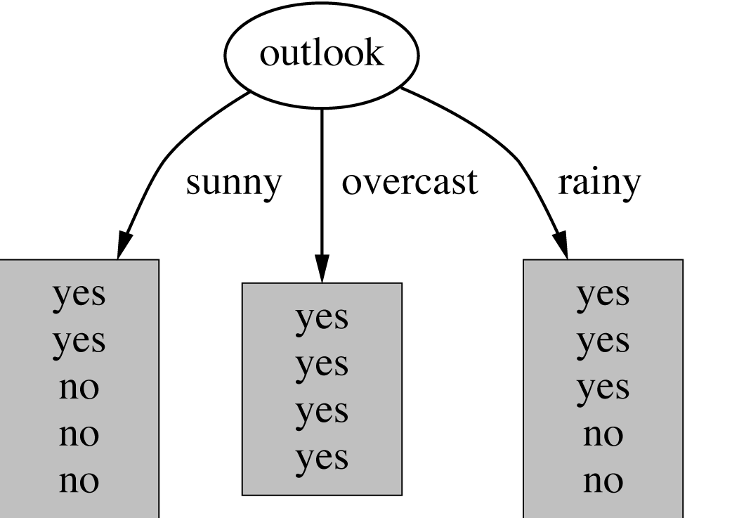
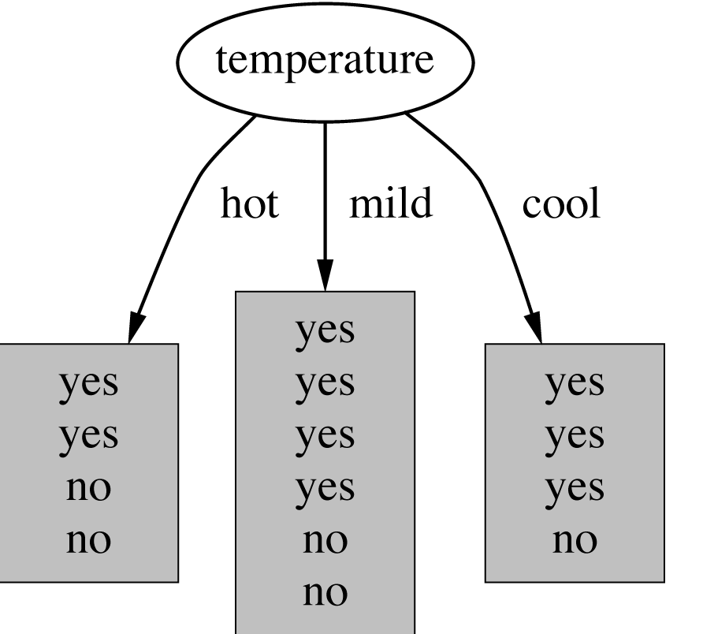
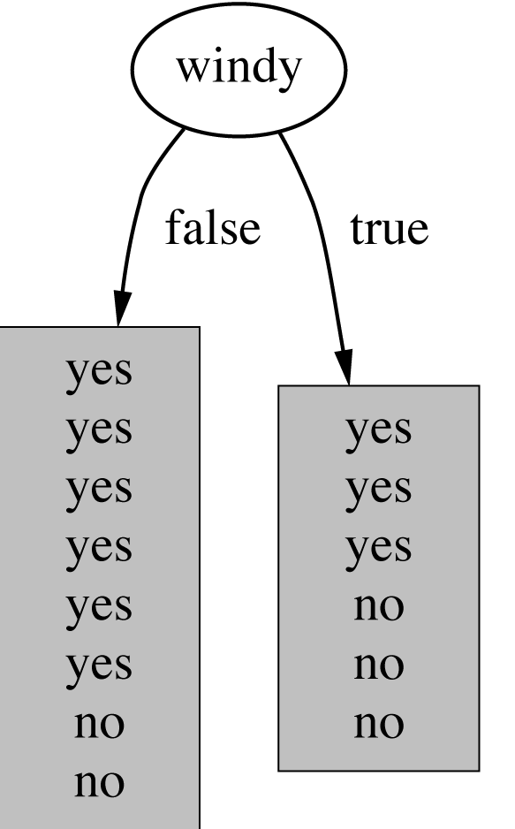
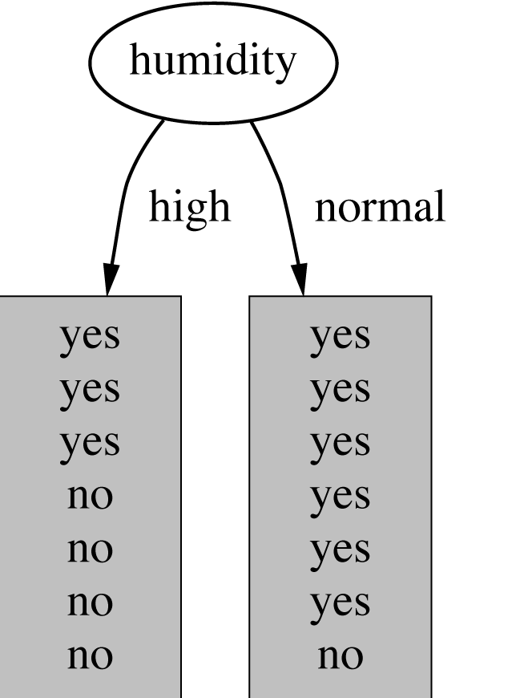
Which Attributes to Select?

Slide 5
A Criterion for Attribute Selection
Which is the best attribute?
The one which will result in the smallest tree
Heuristic: choose the attribute that produces the “purest” nodes
Outlook
overcast
Yes

Slide 6
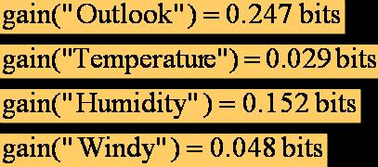
Information gain:
(information before split) – (information after split)
Information gain for attributes from weather data:

Slide 7
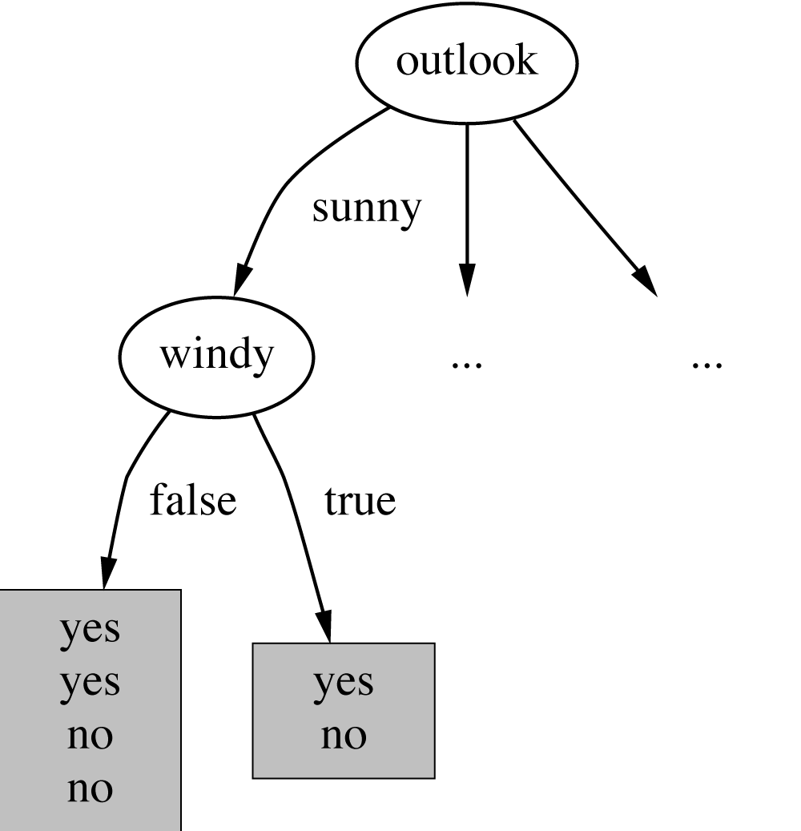
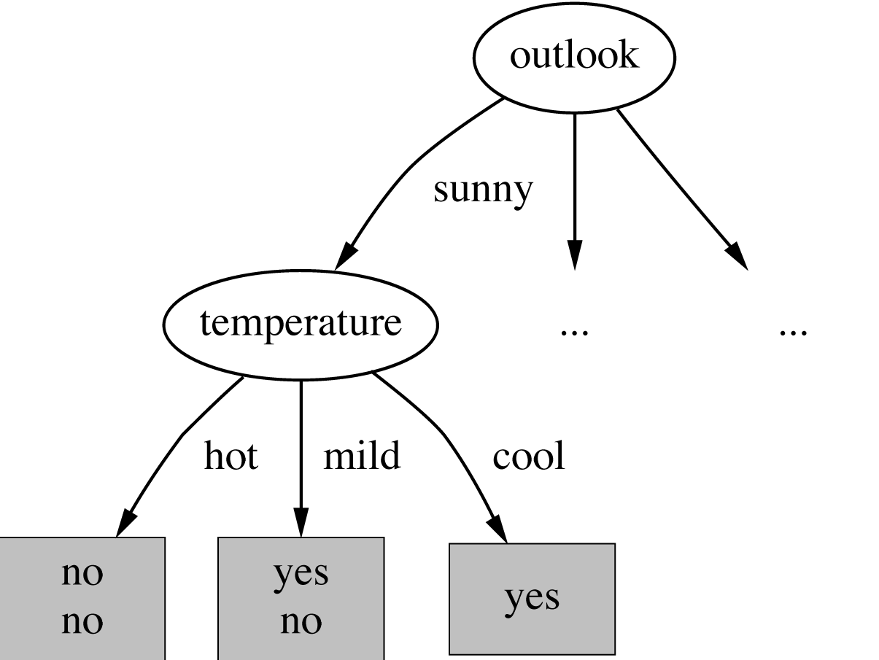
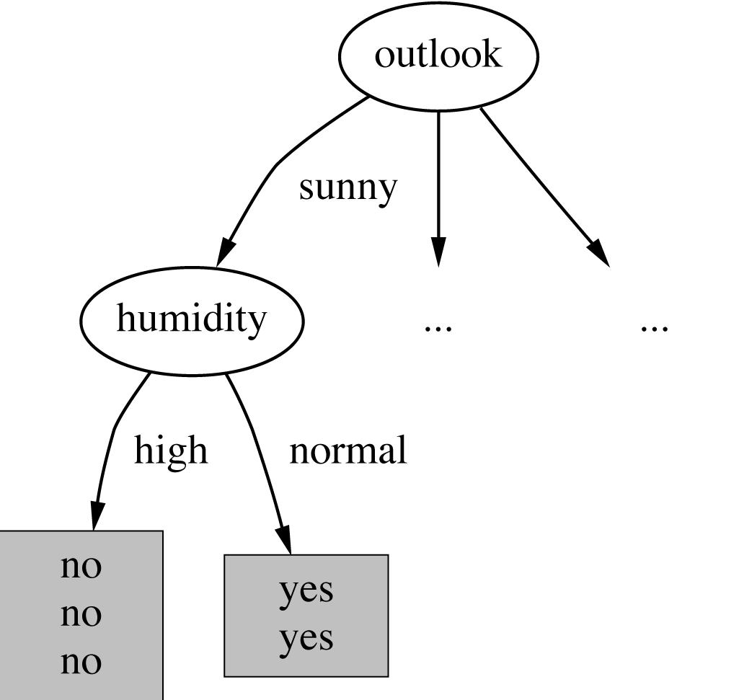
Continuing to Split

Slide 8
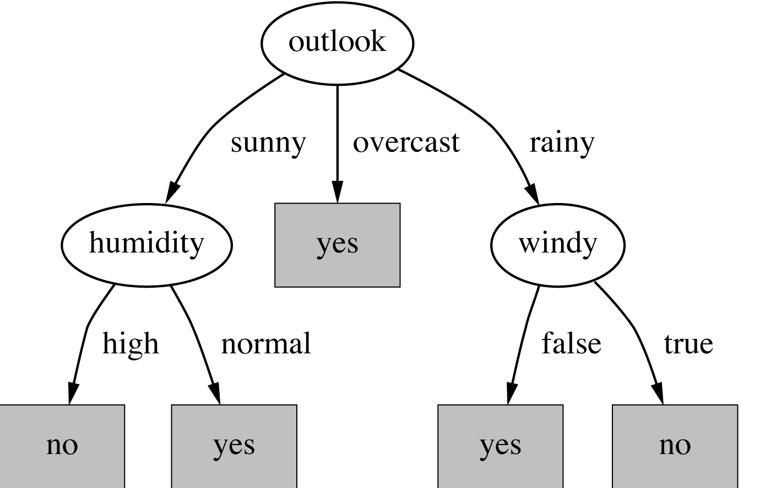
The Final Decision Tree
Splitting stops when data can’t be split any further

Slide 9
Example
Consider the following database defining a concept
Ex Attribute Attribute Attribute Concept
No. Size Colour Shape Satisfied
1 medium blue brick yes
2 small red wedge no
3 small red sphere yes
4 large red wedge no
5 large green pillar yes
6 large red pillar no
7 large green pillar yes

Slide 10
Example
Starting at the root node we have examples {1, 2, 3, 4, 5, 6, 7 }, with information content:
Consider choosing to split on Shape
{1, 2, 3, 4, 5, 6, 7}
Shape
Brick
{1}
Yes
Wedge
{2, 4}
No
Sphere
{3}
Yes
Pillar
{5, 6, 7}
?
This is a pretty good choice, What is the information gain?

Slide 11
Example
Information content of each of the resulting nodes:
For Brick, Wedge and Sphere, all examples are of the same class in the same node (all yes or all no).
For these, information contents is 0, e.g.:
For pillar, we have 2 yes and 1 no examples:
Expected information content of daughter node:
Brick
Wedge
Sphere
Pillar

Slide 12
Example
So, information Gain for choosing Shape is:
Gain(Shape) = 0.9852 – 0.3936 = 0.5916
For others:
E(Size) = 0.8571,
Gain(Size) = 0.1281
E(Colour)=0.4636,
Gain(Colour) = 0.5216

Slide 13
Over Fitting
What is over fitting?
What is its disadvantage? Or why it should be avoided
Generalization become difficult with overfitting
How can we tackle over fitting problems
What is the difference between Discrete and Continuous variables?
Can ID3 handle continuous variables?

Slide 14
Tree Pruning
Many Branches of the built tree shows anomalies due to Noise or Outliers
Overfitting can also be a problem in DTs
Statistical methods are used to remove the least reliable branches
Two common strategies for tree pruning are,
Pre pruning
Post pruning

Slide 15
Pre Pruning
In Pre Pruning technique tree is pruned by halting its construction early
This is done by giving a stopping criterion
Further split of the node is halted
Upon halting the node becomes a leaf
The leaf may hold the most frequent class among the subset sample or the probability distribution of those samples

Slide 16
Pre Pruning - Stopping Criterion
Based on statistical significance test
Stop growing the tree when there is no statistically significant association between any attribute and the class at a particular node
Most popular test: chi-squared test
ID3 used chi-squared test in addition to information gain
Only statistically significant attributes were allowed to be selected by information gain procedure

Slide 17
Pre Pruning - Stopping Criterion
Choice of an appropriate threshold is difficult
A higher value of threshold would result in oversimplified tree
A lower threshold value give very little simplification

Slide 18
Post Pruning
In post pruning branches are removed from a fully grown tree
The lowest unpruned node becomes leaf and is labeled with the most frequent class among its former branches
For each non-leaf node, post pruning algorithm calculates the expected error rate if pruning is done
Also the expected error rate is calculated if pruning is not done using the error rate for each branch
Pruning is done if the weighted expected error is less with pruning otherwise branch is not pruned

Slide 19
Post Pruning
Post pruning requires more computation but have more reliable and accurate results
Some times practitioners combined both techniques to get good results with comparatively less computation

Slide 20
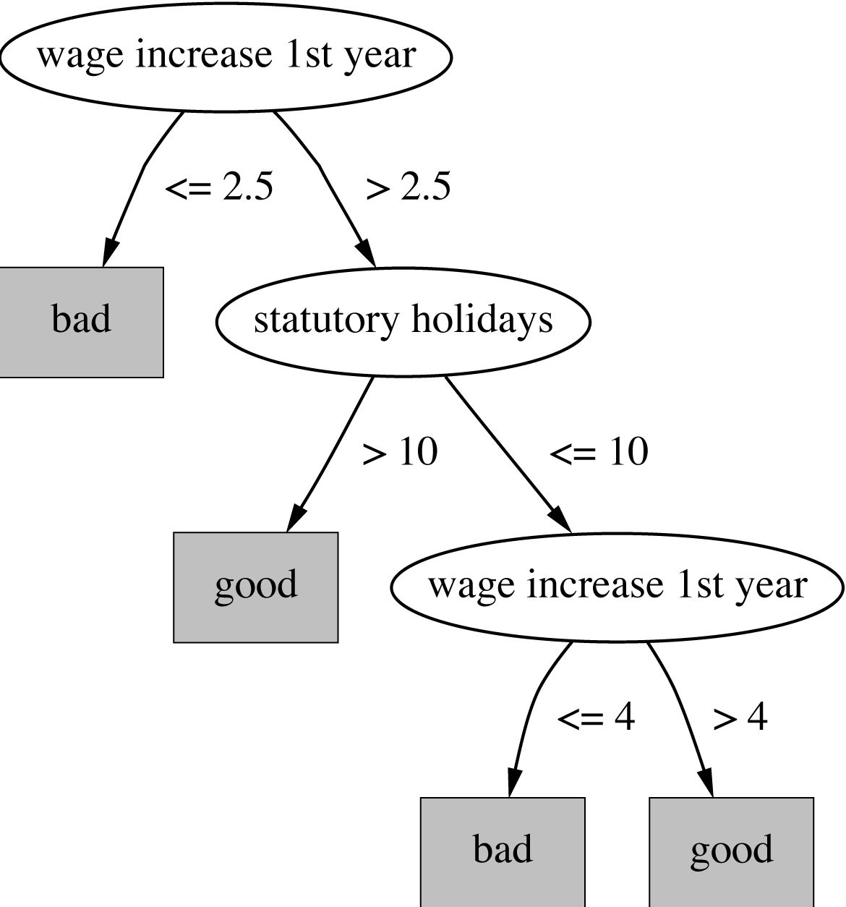
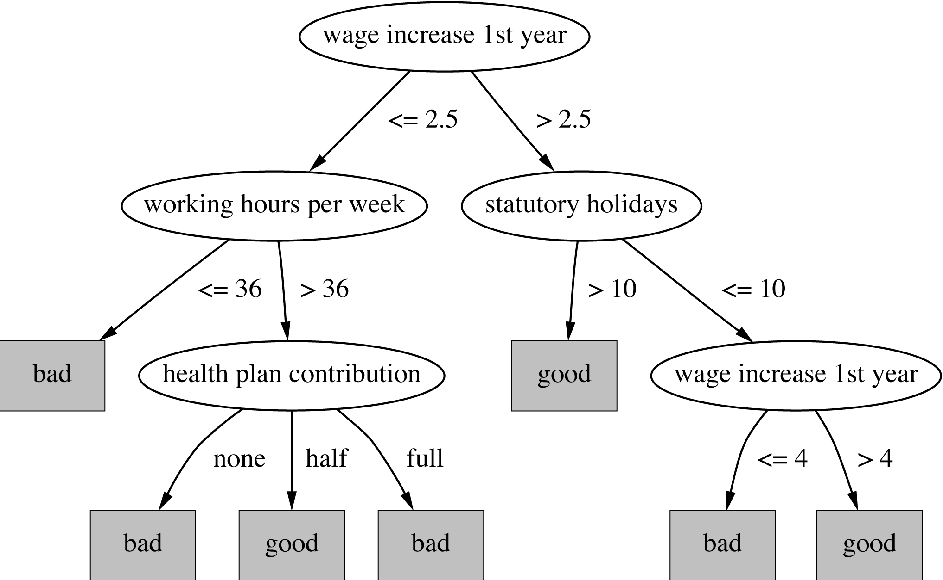
Post Pruning

Slide 21
Rule Induction
Classification Rule in the form of IF – THEN can be extracted from Decision Trees
One rule is extracted for each path from root node to leaf node
Each attribute-value pair forms the conjunction of the antecedent (“IF”) part
The leaf node holds the class prediction, forms the consequent (“THEN”) part
IF-THEN rules are easier for humans to understand specially when the tree is complex and large

Slide 22
Rule Induction
Rule can be pruned if the part of the antecedent does not effect the estimated accuracy of the rule
Rules within a class may then be ranked according to their estimated accuracy
Rules accuracy can be estimated using the test data sample
Can produce duplicate rules
Check for this at the end

Slide 23
C 4.5
Handling Numeric Attributes
Finding Best Split(s)
Dealing with Missing Values

Slide 24
Industrial-strength algorithms
For an algorithm to be useful in a wide range of real-world applications it must:
Permit numeric attributes
Allow missing values
Be robust in the presence of noise
Basic schemes such as ID3 need to be extended to fulfill these requirements

Slide 25
C4.5 History
ID3
C4.5 innovations (Quinlan):
permit numeric attributes
deal sensibly with missing values
pruning to deal with noisy data
C4.5 - one of best-known and most widely-used learning algorithms
Last research version: C4.8, implemented in Weka as J4.8 (Java)
Commercial successor: C5.0 (available from Rulequest)
Notes:
Chi-Square Automation Interaction Detection

Slide 26
Numeric Attributes
Standard method: binary splits
e.g. temp < 45
Unlike nominal attributes, every attribute has many possible split points
Solution is straightforward extension:
Evaluate info gain (or other measure) for every possible split point of attribute
Choose “best” split point
Info gain for best split point is info gain for attribute
Computationally more demanding

Slide 27
Weather Data
ID | Outlook | Temperature | Humidity | Windy | Play?
A | sunny | hot | high | false | No
B | sunny | hot | high | true | No
C | overcast | hot | high | false | Yes
D | rain | mild | high | false | Yes
E | rain | cool | normal | false | Yes
F | rain | cool | normal | true | No
G | overcast | cool | normal | true | Yes
H | sunny | mild | high | false | No
I | sunny | cool | normal | false | Yes
J | rain | mild | normal | false | Yes
K | sunny | mild | normal | true | Yes
L | overcast | mild | high | true | Yes
M | overcast | hot | normal | false | Yes
N | rain | mild | high | true | No

Slide 28
Weather data – nominal values
Outlook | Temperature | Humidity | Windy | Play
Sunny | Hot | High | False | No
Sunny | Hot | High | True | No
Overcast | Hot | High | False | Yes
Rainy | Mild | Normal | False | Yes
… | … | … | … | …
If outlook = sunny and humidity = high then play = no If outlook = rainy and windy = true then play = no If outlook = overcast then play = yes If humidity = normal then play = yes If none of the above then play = yes

Slide 29
Weather data - Numeric
64 65 68 69 70 71 72 72 75 75 80 81 83 85 Yes No Yes Yes Yes No No Yes Yes Yes No Yes Yes No
Outlook | Temperature | Humidity | Windy | Play
Sunny | 85 | 85 | False | No
Sunny | 80 | 90 | True | No
Overcast | 83 | 86 | False | Yes
Rainy | 75 | 80 | False | Yes
… | … | … | … | …
If outlook = sunny and humidity > 83 then play = no If outlook = rainy and windy = true then play = no If outlook = overcast then play = yes If humidity < 85 then play = yes If none of the above then play = yes

Slide 30
Example
Split on temperature attribute:
E.g. temperature < 71.5: yes/4, no/2 temperature ≥ 71.5: yes/5, no/3
Info([4,2],[5,3]) = 6/14 info([4,2]) + 8/14 info([5,3]) = 0.939
Place split points halfway between value
64 65 68 69 70 71 72 72 75 75 80 81 83 85 Yes No Yes Yes Yes No No Yes Yes Yes No Yes Yes No

Slide 31
Speeding up
Entropy only needs to be evaluated between points of different classes
value
class
64 65 68 69 70 71 72 72 75 75 80 81 83 85 Yes No Yes Yes Yes No No Yes Yes Yes No Yes Yes No
X
Potential optimal breakpoints
Breakpoints between values of the same class cannot be optimal

Slide 32
Questions
?

